Slide 1

Online Education
Mini Project-I (K24MCA18P) Odd Semester Session 2024-25
Team Leader: Kunal Prajapati - 2426MCA667
Members:
Krishna Sharma- 2426MCA628
Project Supervisor:
Mr. Arpit Dogra
Assistant Professor

Slide 2
Content
Introduction (1 slide)
Literature Review (2 slides)
Objective of the Project (1 slide)
Technology
Hardware Requirements
Software Requirements (Language and Platforms)
Modules (2 slides)
Workflow (1 slide)
Reports (1 slide)
References (1 slide)
Notes:
Font Styles: Times New Roman + Font Size: 25

Slide 3
Introduction
The introduction should provide background information, the purpose of the study, and the objectives.
With the rapid advancement of technology and the global shift towards remote learning, online education has become a significant part of the educational landscape. This project investigates how online education platforms are developed, their impact on learning experiences, and the factors contributing to their success or failure. The purpose is to analyze the effectiveness of an online learning system and its ability to deliver quality education remotely. The objectives include examining student engagement, interaction models, and technological requirements.
Notes:
Font Styles: Times New Roman + Font Size: 25

Slide 4
Literature Review
Online Education management applications have evolved significantly with the rise of productivity tools.
Flexibility: Learn anytime, anywhere.
Cost-Effective: Lower cost compared to traditional education.
Diverse Course Options: Access to a wide range of subjects.
Accessibility: Removes geographical barriers.
Notes:
Font Styles: Times New Roman + Font Size: 25

Slide 5
Objective of the Project
To develop an accessible and user-friendly online learning platform that provides educational resources to students regardless of geographical location or time constraints.
To assess the effectiveness of online education by analyzing student engagement, retention, and academic performance in comparison to traditional in-classroom education.
To identify and address challenges such as technical barriers, the digital divide, and reduced face-to-face interaction in online learning environments.
Notes:
Font Styles: Times New Roman + Font Size: 25

Slide 6
Technology (Hardware Requirements)
No specific hardware requirements.
The application is designed to run on any standard device capable of running modern web browsers.
Notes:
Font Styles: Times New Roman + Font Size: 25

Slide 7
Technology (Software Requirements)
Frontend: HTML, CSS, JavaScript
Backend: MySQL for data storage
The application is built with web technologies, allowing it to run seamlessly on multiple platforms.
Platform used : VS Code.
Notes:
Font Styles: Times New Roman + Font Size: 25

Slide 8
Modules
User registration (students, teachers, admin)
Authentication and authorization (login, password reset)
Role-based access control (admin, teacher, student)
Profile management (update personal details, course history)
Notes:
Font Styles: Times New Roman + Font Size: 25

Slide 9
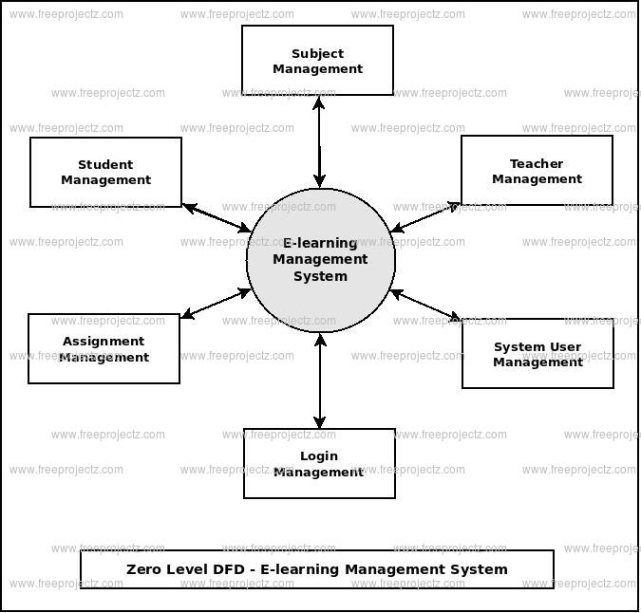
DFD-Diagram

Slide 10
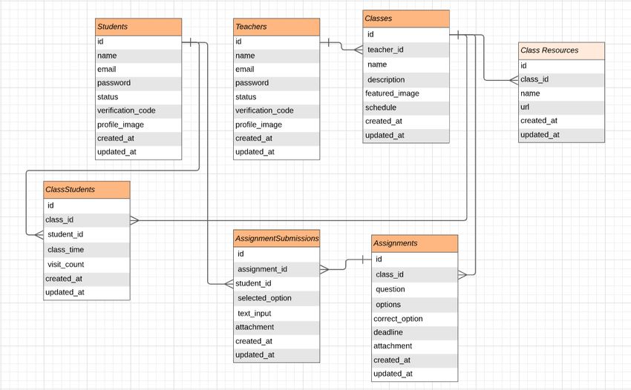
ER-Diagram

Slide 11
Workflow
Registration: User register to login in the system.
User Login: Users log in to access the system.
3. Dashboard : Users view all courses (pending, completed, or overdue) on the main dashboard.
4. Courses: User view all the courses uploaded by the teacher.
5. Teachers: View the profile of every teacher and also courses which are uploaded by specific teacher.
6. Contact us: Anyone who has a query they can contact us.
7. Logout: Users log out after taking course.
Notes:
Font Styles: Times New Roman + Font Size: 25

Slide 12

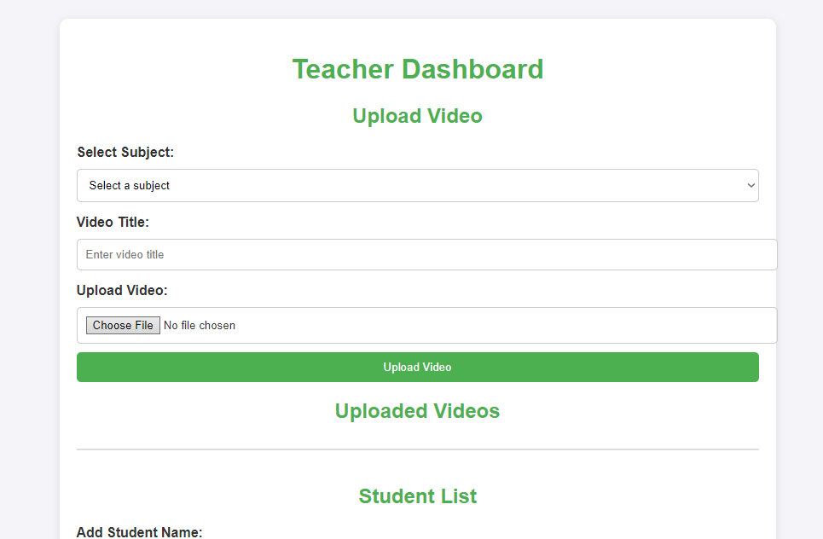
Reports
Notes:
Font Styles: Times New Roman + Font Size: 25

Slide 13

Web Interface

Slide 14


Slide 15
References
Moore, M. G., & Kearsley, G. (2011). Distance Education: A Systems View of Online Learning. Belmont, CA: Wadsworth.
This book provides an in-depth view of distance education with a focus on the systems involved in online learning. It discusses theories, models, and best practices for online education.
Garrison, D. R., & Anderson, T. (2003). E-Learning in the 21st Century: A Framework for Research and Practice. Routledge.
A comprehensive guide to the e-learning framework. This book explores the pedagogical and technological aspects of online education, along with its impact on higher education.
Means, B., Toyama, Y., Murphy, R., Bakia, M., & Jones, K. (2009). Evaluation of Evidence-Based Practices in Online Learning: A Meta-Analysis and Review of Online Learning Studies. U.S. Department of Education.
A meta-analysis report that provides data on the effectiveness of online learning compared to face-to-face learning. It discusses the benefits, challenges, and opportunities that online education presents.
Anderson, T. (Ed.). (2008). The Theory and Practice of Online Learning. Athabasca University Press.
Notes:
Font Styles: Times New Roman + Font Size: 25

Slide 16
Thank you
Dear friends

